Slide 1

Lecture 7
Inference for Averages
Notes:
For binomial you always use Z test.
T test is for normal dist with unknown sigma

Slide 2
In a 1965 study, seven first-graders at a California school were identified as “growth spurters”

Slide 3
In a 1965 study, seven first-graders at a California school were identified as “growth spurters”
These students had their IQ’s measured and then measured again one year later

Slide 4
In a 1965 study, seven first-graders at a California school were identified as “growth spurters”
These students had their IQ’s measured and then measured again one year later
The increases in IQ were equivalent to
8 15 23 29 35 40 42

Slide 5
Increase in IQ for seven first-graders identified as “growth spurters”
8 15 23 29 35 40 42
Assume these data are a simple random sample of “growth spurters”

Slide 6
Increase in IQ for seven first-graders identified as “growth spurters”
8 15 23 29 35 40 42
Assume these data are a simple random sample of “growth spurters”
What we can do: for the population of “growth spurters”, what proportion would show an increase of 30 or more IQ points?

Slide 7
Increase in IQ for seven first-graders identified as “growth spurters”
8 15 23 29 35 40 42
Assume these data are a simple random sample of “growth spurters”
What we can not (yet) do: for the population of “growth spurters”, could it be that the average increase in IQ is 30 IQ points?

Slide 8
Lecture 7
Inference for Averages

Slide 9
Lecture 7: Inference for Averages
Inference for one average …
… where σ is known: normal distribution
… where σ is unknown: T distribution
Inference for two matched populations
Inference for two independent populations
… where σ’s might be different
… where σ’s are known to be equal

Slide 10
Lecture 7: Inference for Averages
Inference for one average …
… where σ is known: normal distrib.
… where σ is unknown: T distribution
Inference for two matched populations
Inference for two independent populations
… where σ’s might be different
… where σ’s are known to be equal

Slide 11
Inference for one population average where population values are normally distributed and pop. SD (σ) is known
Inference:
Use  to estimate population average μ
 is random: calculate SE() as σ / sqrt(n)
Note that SD and SE() are not the same thing:
σ is the spread among individual items
SE() is the variation from one  to another
Perform inference using normal distribution

Slide 12
Change in IQ for seven first-graders:
8 15 23 29 35 40 42
Assume these 7 students are a SRS from pop. of “growth spurters”; assume IQ changes in the pop. are normal, σ = 12.791
Let μ = average change in IQ in population

Slide 13
Change in IQ for seven first-graders:
8 15 23 29 35 40 42
Assume these 7 students are a SRS from pop. of “growth spurters”; assume IQ changes in the pop. are normal, σ = 12.791
Let μ = average change in IQ in population
What is a 95% confidence interval for μ?
Point estimate for μ is  = 27.43
SE() = σ / sqrt(n) = 12.791/ sqrt(7) = 4.835
For 95% conf. with σ known, use normal: Z = 1.96
→ 95% confidence interval for μ is 17.95 to 36.90

Slide 14
Change in IQ for seven first-graders:
8 15 23 29 35 40 42
Assume these 7 students are a SRS from pop. of “growth spurters”; assume IQ changes in the pop. are normal, σ = 12.791
Let μ = average change in IQ in population
Could it be that μ is only 19.0?
H₀: μ = 19 (even though sample suggest μ ~ 27)
Observed  = 27.43, SE() = σ / sqrt(n) = 4.835
Z = (27.43 – 19.0) / 4.835 = 1.743, p = 0.0406
Reject H₀: for population of GS, μ > 19.0

Slide 15
Change in IQ for seven first-graders:
8 15 23 29 35 40 42
Assume these 7 students are a SRS from pop. of “growth spurters”; assume IQ changes in the pop. are normal, σ = 12.791
Let μ = average change in IQ in population
If we know σ = 12.791, 95% CI for μ is 17.95 to 36.90 IQ points, and we know μ > 19.0
What if we don’t know the population SD?

Slide 16
Lecture 7: Inference for Averages
Inference for one average …
… where σ is known: normal distribution
… where σ is unknown: T distribution
Inference for two matched populations
Inference for two independent populations
… where σ’s might be different
… where σ’s are known to be equal

Slide 17
Inference for one population average where population values are normally distributed, pop. SD (σ) is not known
Use  to estimate population average μ
Calculate s = sample SD
Use s to estimate population SD σ
Estimate SE() as s / sqrt(n)
Perform inference using a T distribution with n-1 degrees of freedom

Slide 18
The T_{k} distribution (“T distribution with k degrees of freedom”) is like a normal distribution for small samples
Use t when you have a (small) random sample from a normally distributed population but don’t know the pop. SD σ
For large degrees of freedom, t_{k} → normal
For any given tail probability, T values are larger than values from the normal curve: this accounts for the uncertainty when estimating σ

Slide 19
Comparing T distribution to normal:
For 95% confidence with T₂, you would need +4.3 SE’s, not +1.96 SE’s!
 | Area in one tail of distribution
df | 10% | 5% | 2.5% | 1.0% | 0.50%
1 | 3.078 | 6.314 | 12.706 | 31.821 | 63.657
2 | 1.886 | 2.920 | 4.303 | 6.965 | 9.925
5 | 1.476 | 2.015 | 2.571 | 3.365 | 4.032
10 | 1.372 | 1.812 | 2.228 | 2.764 | 3.169
100 | 1.290 | 1.660 | 1.984 | 2.364 | 2.626
1000 | 1.282 | 1.646 | 1.962 | 2.330 | 2.581
Normal | 1.282 | 1.645 | 1.960 | 2.326 | 2.576

Slide 20
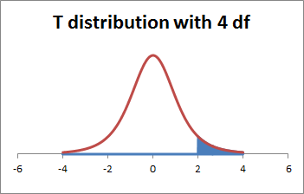
The T-distribution in Excel (1/2)
To find the tail area to the right of a given positive value of x, use =TDIST(x, [df] , 1)
Note: =TDIST(x, [df], 1) only accepts positive values for x; areas for x < 0 are found by using the fact that P(T < –x) = P(T > x)
=TDIST(2,4,1) gives the area to the right of x=2 from a T-distribution with 4 df … area = 5.8%

Slide 21
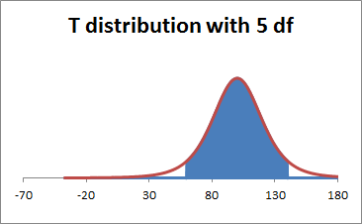
The T-distribution in Excel (2/2)
To find the T-value for a (1–p) x 100% confidence interval, use =TINV(p, [df] )
To find the T-value corresponding to a tail area of p%, use =TINV(2*p, [df] ), since Excel finds T assuming you want the area in both tails
=TINV(0.10,5) gives the T-value for a 90% confidence interval based on a a T-distribution with 5 df …
T = 2.015

Slide 22
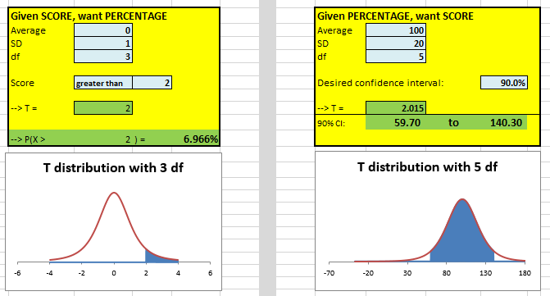
An Excel file has been created to help visualize T distributions

Slide 23
Reminder: inference for one population average where population values are normally distributed, pop. SD (σ) is not known
Use  to estimate population average μ
Calculate sample SD s
Use s to estimate population SD σ
Estimate SE() as s / sqrt(n)
Perform inference using T distribution with n-1 degrees of freedom

Slide 24
Change in IQ for seven first-graders:
8 15 23 29 35 40 42
Assume these 7 students are a SRS from pop. of “growth spurters”; assume IQ changes in the pop. are known to be normal but that pop. SD σ is unknown

Slide 25
Change in IQ for seven first-graders:
8 15 23 29 35 40 42
Assume these 7 students are a SRS from pop. of “growth spurters”; assume IQ changes in the pop. are known to be normal but that pop. SD σ is unknown
Now what is a 95% confidence interval for μ?
Est. change is  = 27.43, sample SD is s = 12.791
Estimated SE() = s / sqrt(n) = 4.835
For 95% conf, n=7 → T₆ = TINV(0.05,6) = 2.447
→ 95% CI for μ is 27.43 + (2.447)(4.835) = 5.60 to 39.26

Slide 26
Change in IQ for seven first-graders:
8 15 23 29 35 40 42
Assume these 7 students are a SRS from pop. of “growth spurters”; assume IQ changes in the pop. are known to be normal but that pop. SD σ is unknown
Now could it be that μ = 19.0?
H₀: μ = 19.0 (even though sample suggest μ ~ 27)
 = 27.43, s = 12.791, est. SE() = s/sqrt(n) = 4.835
T = (27.43 – 19) / 4.835 = 1.743, compare to T₆
p = 0.066 (from Excel, =TDIST(1.743,6,1) )
FAIL to reject H₀: it might be the case that μ = 19

Slide 27
Comments
If we assumed that we knew σ = 12.791, and we had stat. signif. proof that μ > 19.0
If we did not know σ and used the sample SD of 12.791, we did not have statistically significant proof that μ > 19.0 (i.e., we can not rule out the possibility that μ = 19.0)
The uncertainty due to not knowing σ increased the uncertainty enough to change results from significant to not significant

Slide 28
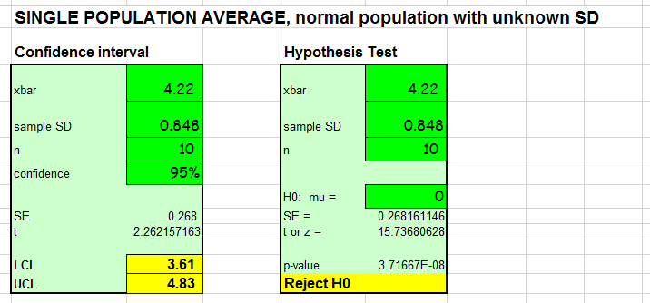
An Excel template has been created for using the T distribution for inference for one population

Slide 29
Remark: the methods for analyzing one population average can also be used with matched-pair data
In a matched-pair data set, there are two samples, and every item in the first sample can be logically matched up with exactly one item in a second sample
Examples of matched-pair data
Comparing before and after weight in dieters
Comparing ages of husbands and wives

Slide 30



Lecture 7: Inference for Averages
Inference for one average …
… where σ is known: normal distribution
… where σ is unknown: T distribution
Infer. for two matched populations
Inference for two independent populations
… where σ’s might be different
… where σ’s are known to be equal

Slide 31
Analyzed matched-pair data:
Reminder: in matched-pair data, there are two samples, but every item in the first sample can be logically matched up with exactly one item in a second sample
If the data are matched-pairs, take differences between the paired values, and then analyze the differences as a single population
Note this technique only makes sense if the data are matched pairs

Slide 32
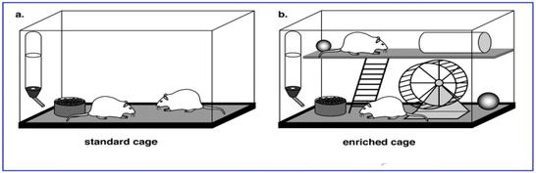
Example: matched-pairs for rats
11 litters of rats were available for study
From each litter, a pair of rats was selected
One rat per pair was given a “standard” environment
One rat per pair was given an “enriched” environment with toys, etc.

Slide 33
Example: matched-pairs for rats
After two years, the rats were dissected and had their brain weights measured

Slide 34
Why would the researchers go through the difficulty of using pairs of rats, rather than just using two separate sets of rats?
Cortex weights
 | Enr. | Std.
1 | 689 | 657
2 | 656 | 623
3 | 668 | 652
4 | 660 | 654
5 | 679 | 658
6 | 663 | 646
7 | 664 | 600
8 | 647 | 640
9 | 694 | 605
10 | 633 | 635
11 | 653 | 642
Avg | 664.2 | 637.5

Slide 35
Since we have matched pair data, take differences …
Example questions:
Is the difference in weights “statistically significant”?
What is a 90% conf. interval for the effect of enrichment?
Cortex weights
 | Enr. | Std. | Diff
1 | 689 | 657 | 32
2 | 656 | 623 | 33
3 | 668 | 652 | 16
4 | 660 | 654 | 6
5 | 679 | 658 | 21
6 | 663 | 646 | 17
7 | 664 | 600 | 64
8 | 647 | 640 | 7
9 | 694 | 605 | 89
10 | 633 | 635 | –2
11 | 653 | 642 | 11
Avg | 664.2 | 637.5 | 26.7

Slide 36
Test of significance:
H₀: no effect, Δ = 0
Avg diff = 26.7 mg
SD of diff = 27.3 mg
SE() = 27.3 / sqrt(11) = 8.24 mg
t = (26.7 – 0) / 8.24 = 3.24 with 10 df
From Excel, p-value = 0.00441, or 1 in 227
Conclusion?
Cortex weights
 | Enr. | Std. | Diff
1 | 689 | 657 | 32
2 | 656 | 623 | 33
3 | 668 | 652 | 16
4 | 660 | 654 | 6
5 | 679 | 658 | 21
6 | 663 | 646 | 17
7 | 664 | 600 | 64
8 | 647 | 640 | 7
9 | 694 | 605 | 89
10 | 633 | 635 | –2
11 | 653 | 642 | 11
Avg | 664.2 | 637.5 | 26.7
Notes:
Interpretation of:
SD: if I randomly pick 2 samples, what’s the deviation between the 2?
SE: deviation of the samples size 11 (compare one sample of 11 to another sample of 11)
Here we should compare mean of 11 to deviation of 11(SE), not deviation of randomly 2(SD)

Slide 37
90% CI for the effect of enrichment:
Avg diff = 26.7 mg
SD of diff = 27.3 mg
SE() = 27.3 / sqrt(11) = 8.24 mg
For 90% conf. from T₁₀, T = 1.812
90% conf. interval: 26.7 + (1.812)(8.24), or 11.8 to 41.6 mg
~2% to ~7% increase
Cortex weights
 | Enr. | Std. | Diff
1 | 689 | 657 | 32
2 | 656 | 623 | 33
3 | 668 | 652 | 16
4 | 660 | 654 | 6
5 | 679 | 658 | 21
6 | 663 | 646 | 17
7 | 664 | 600 | 64
8 | 647 | 640 | 7
9 | 694 | 605 | 89
10 | 633 | 635 | –2
11 | 653 | 642 | 11
Avg | 664.2 | 637.5 | 26.7

Slide 38
Did enrichment cause the rats’ brains to grow?
Cortex weights
 | Enr. | Std. | Diff
1 | 689 | 657 | 32
2 | 656 | 623 | 33
3 | 668 | 652 | 16
4 | 660 | 654 | 6
5 | 679 | 658 | 21
6 | 663 | 646 | 17
7 | 664 | 600 | 64
8 | 647 | 640 | 7
9 | 694 | 605 | 89
10 | 633 | 635 | –2
11 | 653 | 642 | 11
Avg | 664.2 | 637.5 | 26.7

Slide 39
Matched pair tests can reduce sources of variability
Some mice litters might be heavier than others; by sampling pairs from each litter, we eliminate litter-to-litter variation in weight (and thus in average brain weight)
When asking if diets work, looking at before and after weight for individuals has less variability than looking at “overall weight of some set of before” versus “overall weight of some set of after”

Slide 40
Matched pair tests can reduce variability, if matching makes sense and is done in a reasonable way
Matched pair tests are not always appropriate … sometimes, we really do have separate groups

Slide 41
Example: Pygmalion in the Classroom
In a 1965 study, 55 first-graders at a California school had their IQ’s measured

Slide 42
Example: Pygmalion in the Classroom
In a 1965 study, 55 first-graders at a California school had their IQ’s measured
The students were given the “Harvard Test of Inflected Acquisition” (HTIA). Seven of the 55 first-graders were identified as “growth spurters”

Slide 43
Example: Pygmalion in the Classroom
All 55 students had their IQ’s tested a year later, and the change in IQ was calculated:
GS n= 7, _{GS} = 27.43, s_{GS} = 12.791
Non-GS n=48, _{non} = 12.00, s_{non} = 12.819

Slide 44
Example: Pygmalion in the Classroom
All 55 students had their IQ’s tested a year later, and the change in IQ was calculated:
GS n= 7, _{GS} = 27.43, s_{GS} = 12.791
Non-GS n=48, _{non} = 12.00, s_{non} = 12.819
The “growth spurt” students showed more improvement than the non-”growth spurt” students … but could it be the case that the respective populations have the same average?

Slide 45
Lecture 7: Inference for Averages
Inference for one average …
… where σ is known: normal distribution
… where σ is unknown: T distribution
Inference for two matched populations
Inference for two independent populations
… where σ’s might be different
… where σ’s are known to be equal

Slide 46
Lecture 7: Inference for Averages
Inference for one average …
… where σ is known: normal distribution
… where σ is unknown: T distribution
Inference for two matched populations
Inference for two independent populations
… where σ’s might be different
… where σ’s are known to be equal
Notes:
When to assume common population variance?
When sample come from the same pool of data or IID dist
i.e.
Use the same scale to measure 2 different objects, the errors are caused by the same tool

Slide 47
Inference for difference of two population averages, both from normal populations, where population SD’s are unknown and might not be equal:
Calculate ₁, s₁, ₂, and s₂
Use ₁–₂ to estimate μ₁–μ₂
Estim. SE(₁–₂) as sqrt[(s₁² / n₁) + (s₂² / n₂)]
Perform inference using T distribution with degrees of freedom equal to the smaller of (n₁–1) and (n₂–1)

Slide 48
Summary of data:
GS n= 7, _{GS} = 27.43, s_{GS} = 12.791
Non-GS n=48, _{non} = 12.00, s_{non} = 12.819
What is a 90% conf. interval for the difference in population averages?
Point estimate of difference is _{GS} – _{non} = 15.43
Est. SE(₁–₂) = sqrt( 12.79²/7 + 12.82²/48) = 5.177
For 90% conf. with σ’s not equal, use T₆ = 1.943
→ 90% conf. interval for difference between “avg. change for pop. of GS” minus “avg. change for pop. of non-GS” is 15.43 + (1.943)(5.177) = 5.37 to 25.49

Slide 49
Summary of data:
GS n= 7, _{GS} = 27.43, s_{GS} = 12.791
Non-GS n=48, _{non} = 12.00, s_{non} = 12.819
90% confidence interval for the difference in population averages is 5.37 to 25.49 points
This is not an interval for individual students
This is an interval about averages: we compare “average gain for all first graders who are ‘growth spurters’ ” versus “average gain for all first graders who are not labeled as ‘growth spurters’ ”

Slide 50
Summary of data:
GS n= 7, _{GS} = 27.43, s_{GS} = 12.791
Non-GS n=48, _{non} = 12.00, s_{non} = 12.819
90% confidence interval for the difference in population averages is 5.37 to 25.49 points
Is it plausible that the two groups are identical?
If the two groups were identical, they would have the same mean and same SD …

Slide 51
Lecture 7: Inference for Averages
Inference for one average …
… where σ is known: normal distribution
… where σ is unknown: T distribution
Inference for two matched populations
Inference for two independent populations
… where σ’s might be different
… where σ’s are known to be equal

Slide 52
Sometimes we might believe that the population SD’s must be equal
If we draw two samples from the same population, the population mean and population SD will be the same for both
If we think (or hypothesize) that two populations are identical, then the populations should have the same mean and the same SD
If we know population SD’s are equal, we can increase our precision

Slide 53
Inference for two population averages where population values are normally distributed, pop. SD’s are not known but are known to be equal (σ₁ = σ₂)
Calculate ₁, s₁, ₂, and s₂
(NEW) Estimate common σ using s_{p} :
s_{p} = sqrt{ [(n₁–1)s₁² + (n₂–1)s₂² ] / (n₁ + n₂ – 2) }
Use ₁–₂ to estimate μ₁–μ₂
Estim. SE(₁–₂) as sqrt[(s_{p}² / n₁) + (s_{p}² / n₂)]
Perform inference using T distribution with df = (n₁–1)+(n₂–1) = n₁ + n₂ – 2

Slide 54
Summary of data:
GS n= 7, _{GS} = 27.43, s_{GS} = 12.791
Non-GS n=48, _{non} = 12.00, s_{non} = 12.819
Is the observed difference “stat. significant”?
H₀: pop. are identical (μ_{GS} = μ_{non}, σ_{GS} = σ_{non})
s_{p} = 12.816 [weighted avg. of s_{GS} and s_{non}]
Estimated SE(₁ – ₂) = 5.185
Obs. T = [(27.43 – 12.00) – 0) / 5.185 = 2.98
Compare to T w/ 53 df … p = 0.002
Reject H₀: populations are not the same!

Slide 55
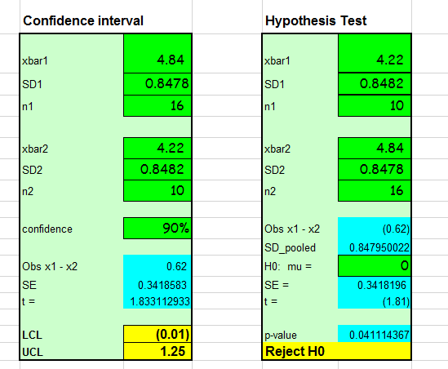
Excel template for inference for two population averages

Slide 56
Example: Pygmalion in the Classroom
Summary: students identified as “growth spurters” showed statistically significant more gain in IQ than non-spurters
Interesting fact: the children designated as “growth spurters” by the Harvard Test of Inflected Acquisition were chosen at random
There is no Harvard Test of Inflected Acquisition
What explains the differences in IQ?

Slide 57
Expectations matter!

Slide 58
Expectations matter!
Positive expectations from others can result in improved performance
“Pygmalion effect”

Slide 59
Expectations matter!
Positive expectations from others can result in improved performance
“Pygmalion effect”
Positive self-expectations can also result in improved performance
“Galatea effect”

Slide 60


https://www.thebalance.com/pygmalion-and-galatea-effects-1918677
These concepts are still current

Slide 61
Expectations matter!
Positive expectations from others can result in improved performance
“Pygmalion effect”
Positive self-expectations can also result in improved performance
“Galatea effect”

Slide 62
Expectations matter!
Positive expectations from others can result in improved performance
“Pygmalion effect”
Positive self-expectations can also result in improved performance
“Galatea effect”
Negative expectations from others can harm performance
“Golem effect”

Slide 63

https://www.usatoday.com/story/ondeadline/2012/10/11/florida-board-education-race-reading-asians/1626837/
These concepts are still current
The plan, approved by the state Board of Education on Tuesday night, calls for 90% of Asian students to be at or above grade level in reading by 2018. It expects whites to be at 88%, Hispanics at 81% and blacks at 74%.
In math, the board expects 92% of Asian students to be scoring at or above grade level, whites at 86%, Hispanic students at 80% and black students at 74%.

Slide 64
These concepts are still current
“I think we need to be realistic in our ability to impact those [racial groups] at the same degree”
-- Board member Kathleen Shanahan
“If Asians can have a goal of 90% in reading, why can't whites, and other subcategories? So I would just ask my fellow board members if we are happy with the signal this sends.”
-- Board member John Padget

Slide 65
Expectations matter!
Positive expectations from self and others can result in improved performance
“Pygmalion effect” and “Galatea effect”
Negative expectations from others can harm performance
“Golem effect”…

Slide 66
Expectations matter!
Positive expectations from self and others can result in improved performance
“Pygmalion effect” and “Galatea effect”
Negative expectations from others can harm performance
“Golem effect”
Studies suggest negative expectations from self can harm performance …

Slide 67
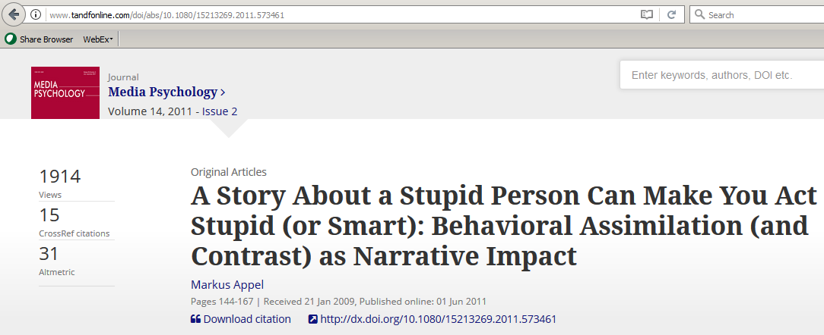
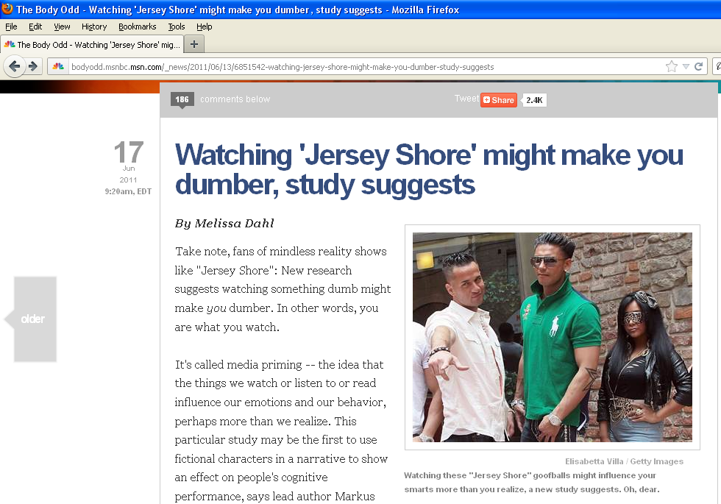
http://bodyodd.msnbc.msn.com/_news/2011/06/13/6851542-watching-jersey-shore-might-make-you-dumber-study-suggests
Expectations matter!
Low self-expectations can result in lower overall performance

Slide 68
Lecture 7: Inference for Averages
Inference for one average …
… where σ is known: normal distribution
… where σ is unknown: T distribution
Inference for two matched populations
Inference for two independent populations
… where σ’s might be different
… where σ’s are known to be equal
Questions so far?

Slide 69
In the 2011 study, 26 men were told they were first to take a Stroop test, and then perform a “lip reading” task for a tester in the next room
n=10 told that tester was to be Daan
n=16 told that tester was to be Daanielle
Test times, based on anticipating the next tester was …
… Daan | 2.81 | 3.33 | 3.64 | 3.89 | 4.11 | 4.33 | 4.55 | 4.80 | 5.11 | 5.63
… Daanielle | 3.25 | 3.71 | 3.98 | 4.18 | 4.34 | 4.50 | 4.64 | 4.77
 | 4.91 | 5.04 | 5.18 | 5.34 | 5.50 | 5.70 | 5.97 | 6.43

Slide 70



Daan (male): n_{M}=10, _{M}= 4.22, s_{M} = 0.8482
Daanielle (fem): n_{F} =16, _{F} = 4.84, s_{F} = 0.8478
Can this difference be explained by luck?
YELLOW
RED BLUE
YELLOW
RED BLUE

Slide 71
Daan (male): n_{M}=10, _{M}= 4.22, s_{M} = 0.8482
Daanielle (fem): n_{F} =16, _{F} = 4.84, s_{F} = 0.8478
Can this difference be explained by luck?
H₀: just luck; for both groups, times are from the same population (μ_{M} = μ_{F}, σ_{M} = σ_{F})
YELLOW
RED BLUE
YELLOW
RED BLUE

Slide 72
Daan (male): n_{M}=10, _{M}= 4.22, s_{M} = 0.8482
Daanielle (fem): n_{F} =16, _{F} = 4.84, s_{F} = 0.8478
Can this difference be explained by luck?
H₀: just luck; for both groups, times are from the same population (μ_{M} = μ_{F}, σ_{M} = σ_{F})
s_{p} = 0.84795 [weighted avg. of s_{M} and s_{F}]
YELLOW
RED BLUE
YELLOW
RED BLUE

Slide 73
Daan (male): n_{M}=10, _{M}= 4.22, s_{M} = 0.8482
Daanielle (fem): n_{F} =16, _{F} = 4.84, s_{F} = 0.8478
Can this difference be explained by luck?
H₀: just luck; for both groups, times are from the same population (μ_{M} = μ_{F}, σ_{M} = σ_{F})
s_{p} = 0.84795 [weighted avg. of s_{M} and s_{F}]
Estimated SE(₁ – ₂) = 0.3418
YELLOW
RED BLUE
YELLOW
RED BLUE

Slide 74
Daan (male): n_{M}=10, _{M}= 4.22, s_{M} = 0.8482
Daanielle (fem): n_{F} =16, _{F} = 4.84, s_{F} = 0.8478
Can this difference be explained by luck?
H₀: just luck; for both groups, times are from the same population (μ_{M} = μ_{F}, σ_{M} = σ_{F})
s_{p} = 0.84795 [weighted avg. of s_{M} and s_{F}]
Estimated SE(₁ – ₂) = 0.3418
Observed T = [(4.84 – 4.22) – 0) / 0.3418 = 1.81
YELLOW
RED BLUE
YELLOW
RED BLUE

Slide 75
Daan (male): n_{M}=10, _{M}= 4.22, s_{M} = 0.8482
Daanielle (fem): n_{F} =16, _{F} = 4.84, s_{F} = 0.8478
Can this difference be explained by luck?
H₀: just luck; for both groups, times are from the same population (μ_{M} = μ_{F}, σ_{M} = σ_{F})
s_{p} = 0.84795 [weighted avg. of s_{M} and s_{F}]
Estimated SE(₁ – ₂) = 0.3418
Observed T = [(4.84 – 4.22) – 0) / 0.3418 = 1.81
Compare to T w/ 24 df … p = 0.04
YELLOW
RED BLUE
YELLOW
RED BLUE

Slide 76
Daan (male): n_{M}=10, _{M}= 4.22, s_{M} = 0.8482
Daanielle (fem): n_{F} =16, _{F} = 4.84, s_{F} = 0.8478
Can this difference be explained by luck?
H₀: just luck; for both groups, times are from the same population (μ_{M} = μ_{F}, σ_{M} = σ_{F})
s_{p} = 0.84795 [weighted avg. of s_{M} and s_{F}]
Estimated SE(₁ – ₂) = 0.3418
Observed T = [(4.84 – 4.22) – 0) / 0.3418 = 1.81
Compare to T w/ 24 df … p = 0.04
Reject H₀: populations are not the same!
YELLOW
RED BLUE
YELLOW
RED BLUE

Slide 77
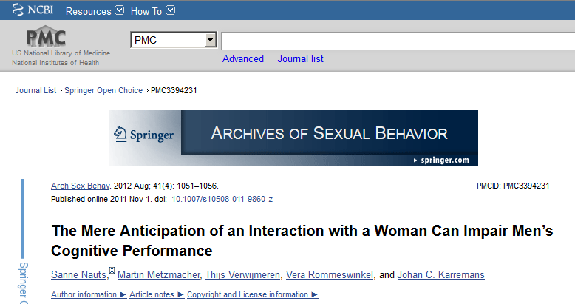
https://www.ncbi.nlm.nih.gov/pmc/articles/PMC3394231/
“The mere anticipation of an interaction with a woman can impair men’s cognitive performance”

Slide 78
Lecture 7: Inference for Averages
Inference for one average …
… where σ is known: normal distribution
… where σ is unknown: T distribution
Inference for two matched populations
Inference for two independent populations
… where σ’s might be different
… where σ’s are known to be equal

Slide 79
So far we have learned how to do many types of inference
One population percentage
Two population percentages
Two population odds
One population average (or matched pairs)
Two population averages
Even more types of inference are possible, depending on the question …

Slide 80
Benford’s Law says that the “expected” proportion of digits starting with d should be equal to log₁₀(1 + 1/d)
Benford’s Law applies to many lists
Example: Population for n=233 countries, 2016
First digit | 1 | 2 | 3 | 4 | 5 | 6 | 7 | 8 | 9
Predicted # | 70.1 | 41.0 | 29.1 | 22.6 | 18.4 | 15.6 | 13.5 | 11.9 | 10.7
Actual # | 69 | 35 | 32 | 21 | 27 | 12 | 13 | 13 | 11

Slide 81
In 1992, Wayne James Nelson wrote a series of 23 checks totaling $1.9M
$ 1,927.48
10/9/92 7,902.31
86,241.90
72,117.46
81,321.75
10/14/92 97,473.96
93,249.11
89,658.17
87,776.89
92,105.83
79,949.16
87,602.93
96,879.27
91,806.47
84,991.67
90,831.83
93,766.67
88,338.72
94,639.49
83,709.28
96,412.21
88,432.86
10/19/92 71,552.16
$ 1,878,687.58

Slide 82
In 1992, Wayne James Nelson wrote a series of 23 checks totaling $1.9M
The first digits of the checks did not seem to follow Benford’s Law
Could the difference in counts be due to luck? How can we tell?
$ 1,927.48
10/9/92 7,902.31
86,241.90
72,117.46
81,321.75
10/14/92 97,473.96
93,249.11
89,658.17
87,776.89
92,105.83
79,949.16
87,602.93
96,879.27
91,806.47
84,991.67
90,831.83
93,766.67
88,338.72
94,639.49
83,709.28
96,412.21
88,432.86
10/19/92 71,552.16
$ 1,878,687.58
First digit | 1 | 2 | 3 | 4 | 5 | 6 | 7 | 8 | 9
Pred. # | 6.9 | 4.1 | 2.9 | 2.2 | 1.8 | 1.5 | 1.3 | 1.2 | 1.1
Actual # | 1 | 1 | 0 | 0 | 0 | 0 | 3 | 9 | 9

Slide 83

Next time: Lecture 8
Inference using χ² distribution

Slide 84

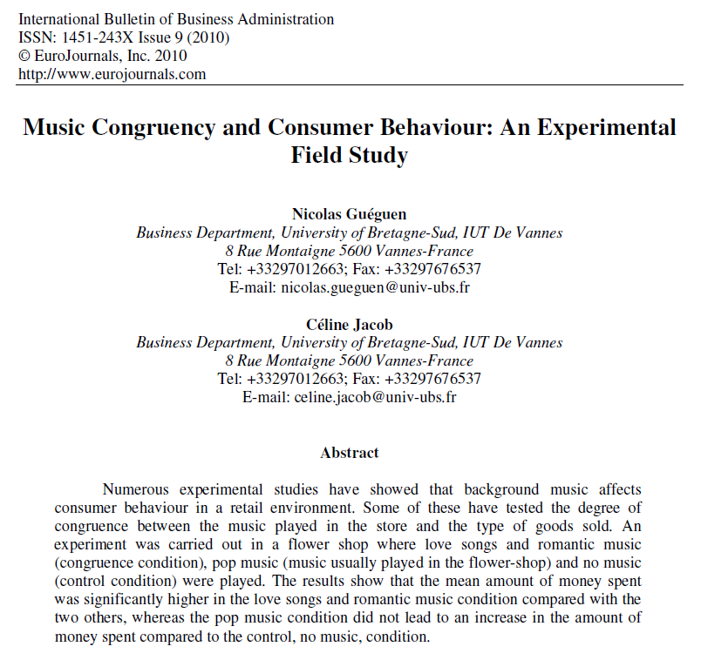
Case Study:
“Music Congruency and Consumer Behavior”

Slide 85
Gueguen and Jacob, “Music Congruency and Consumer Behaviour: An Experimental Field Study”, International Bulletin of Business Administration, 2010
Randomized experiment:
Every 20 minutes, music in flower shop was changed randomly
Y = how much money customers spent
Results:
Type of music | # of customers | Average spent | SD(spent)
Romantic | 38 | 32.55 euro | 9.79 euro
Pop | 43 | 27.21 euro | 6.45 euro
None | 39 | 25.31 euro | 5.58 euro

Slide 86
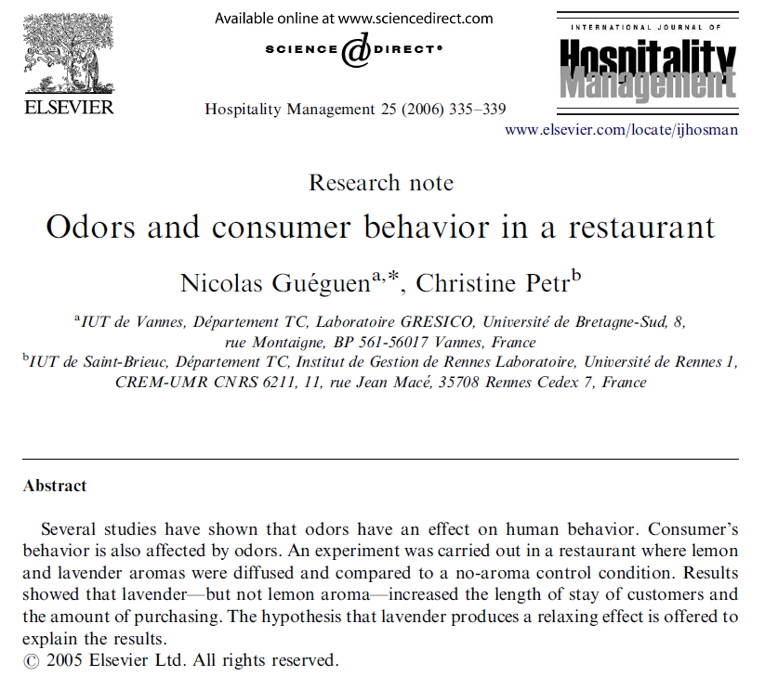
Case Study
“Odors and consumer behavior in a restaurant”

Slide 87
Randomized experiment in “a small pizzeria situated in a small town (3000 inhabitants) of Brittany in France.”
The experiment was conducted from 8 pm to 11 pm during three Saturdays in May.
Two different aromas were tested: natural essential oil of lavender and of lemon
Two response variables: amount of time spent in restaurant and amount of money spent
 | No odor (n=30) | Lemon (n=28) | Lavender (n=30)
Amount of money spent (in Euros)
Mean | 17.5 | 18.1 | 21.1
SD | 2.40 | 2.21 | 2.35

Slide 88
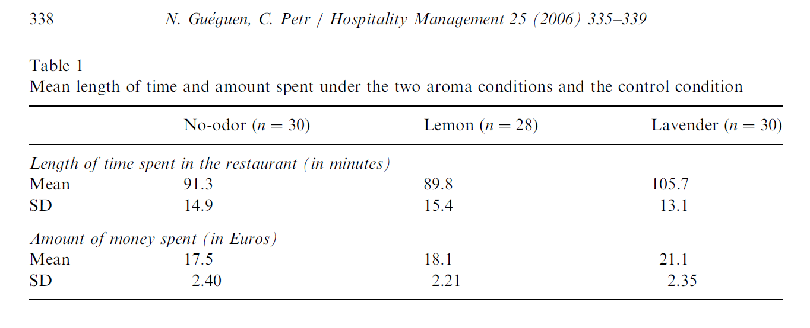

Slide 89
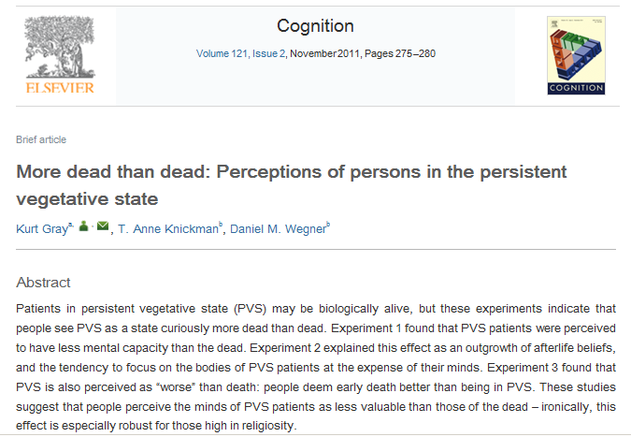
Case Study
“More dead than dead”

Slide 90
Gray et al., “More dead than dead”, Cognition 2011
In a 2011 experiment, participants read one of three stories: a protagonist, David, has a car accident and suffers major injuries.
In the life story, he fully recovers
In the dead story, he dies
In the PVS [persistent vegetative state] story, he enters a PVS: “David’s entire brain was destroyed, except for the one part that keeps him breathing. So while his body is technically alive, he will never wake up again.”

Slide 91
Gray et al., “More dead than dead”, Cognition 2011
Participants then rated David’s mind by indicating the extent to which David could …
“remember the events of his life” “have emotions and feelings”
“be aware of his environment” “know right from wrong”
“influence outcome of situations” “have a personality”
Rating: –3 [strongly disagree] to +3 [strongly agree]
Life (n=60) avg = 1.77, SD = 1.02
Death (n=60) avg = –0.29, SD = 1.76
PVS (n=60) avg = –1.73, SD = 1.36
Is being dead considered to be more “alive” than being in a persistent vegetative state?
What type analysis should be used?

Slide 92
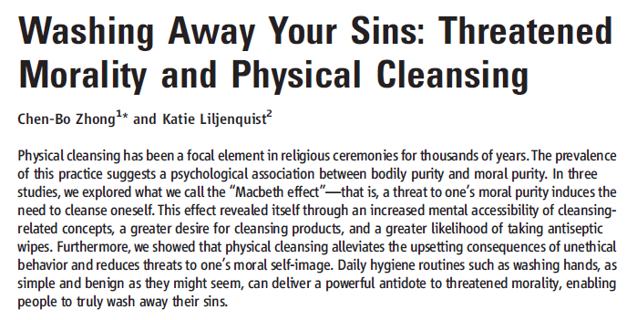

Science, 8 September 2006
Case Study
“Washing Away Your Sins”

Slide 93
A randomized experiment was conducted
n = 16 were asked to recall ethical behavior
n = 16 were asked to recall unethical behavior
Subjects were then offered either a pencil or an antiseptic wipe
Results
For those who were asked to recall ethical behavior, 5/16 chose wipe
For those who were asked to recall unethical behavior, 11/16 chose wipe

Slide 94
Michele Alexander, “Truth and Consequences”, Journal of Sex Research, 2003
Data from GSS, 1972-2006.
SRS of 8068 heterosexual women asked, “Since your 18th birthday, how many male partners have you had sex with?”
SRS of 6707 heterosexual men asked, “Since your 18th birthday, how many female partners have you had sex with?”
“Because a partner is required, it is impossible for men to engage in heterosexual intercourse more often than their female counterparts”

Slide 95
http://pollingreport.com/immigration.htm
CBS, Aug 2017, equivalent to a simple random sample of n = 1111 U.S. adults
“Do you favor of oppose building a wall along the U.S.-Mexico border to try to stop illegal immigration?”
334 R: 240 favor, 87 oppose, 7 unsure
429 D: 39 favor, 378 oppose, 12 unsure
348 I: 121 favor, 214 oppose, 13 unsure

Slide 96
An experiment was conducted in which “sports fans” were shown one of two images
The height of the players was randomized
Judged as fouled 8 / 35 Judged as fouled 38 / 85
Are the rates the same, or did height matter?

Slide 97
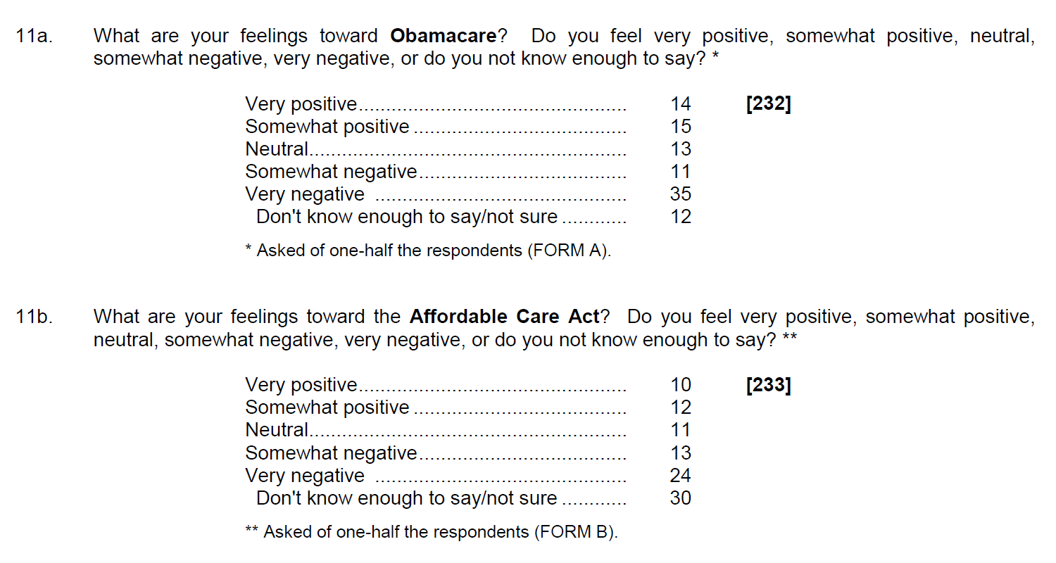
http://www.cnbc.com/id/101064954
In a September 2013 poll of 812 people, half were asked if they support Obamacare, and the other half were asked if they support the Affordable Care Act.

Slide 98
CBS News / NYT poll, 11 Jan 2009:
“All things considered, in our society today, do you think there are more advantages in being a man, or more advantages in being a woman, or [neither has advantage]?”
n = 561 men, 325 said “neither”
n = 551 women, 253 said “neither”

Slide 99
Quiz One, USC BUAD 310, Fall 2008
The same question was asked, but the choices were given in different order
A: “Controlled Experiment” or “Observ. Study”
B: “Observ. Study” or “Controlled Experiment”
Results: 80% of students answered correctly
28 out of 30 getting Form A answered correctly
21 out of 31 getting Form B answered correctly

Slide 100
Summary of methodology for inference for multiple population averages:
State H₀: all populations have the same average
Calculate overall average (and overall SD)
Calculate subgroup averages and SD’s
Compute SS_{model} and MS_{model} = SS_{model} / (k–1)
Compute SS_{error} and MS_{error} = SS_{error} / (n–k)
Compute F = MS_{model} / MS_{error}
Compare calculated F to F_{k–1, n–k}
Make a decision based on the p-value
If you reject H0, you are concluding that at least one of the population means is different from the others

